Slide 1
Places Analysis
Milee Singh Ashawad

Slide 2
Places Analysis
Analysis on the basis of the place given by user
Shows the data related to the images on that location
Analyze the Images to get the attributes like age, gender, smile
Sentiment Analysis on the Comments got from Instagram
Visualization of data on Dashboard

Slide 3
Data Collection
Tourist Place using Google Places API
Find Images of Places on Instagram
Analyze the Image to Get Gender, Smile Attribute and Age Data using Microsoft Face API
Sentiment Analysis on comments from Instagram
Create Dataset for Analysis
Taking the latitude and longitude from the Google Places API
Instagram API will provide the images and the comments on image based on the latitude and longitude
Microsoft Face API will provide the age and gender by analyzing the faces in the images
Above steps are used to create the dataset for analysis

Slide 4
APIs(Application Program Interface)
Google Places API for Autocomplete: Passing the latitude and longitude to Instagram API
Instagram Media API: JSON Array of images URL and other attributes
Instagram Comments API: To get the comments by passing ID of media
Microsoft Face API: Passing image URL to get face Attributes
/api/data API: Created using express package in NodeJS to pass data from AngularJS to NodeJS.
R-Script Package: Transfer data from NodeJS to R

Slide 5
Technologies Used
Angular JS: Client real time web application
Node JS: Acting as a server between Angular JS and R
R: Used for Analysis
Angular Charts.JS: Plotting the graph

Slide 6
Web Dashboard
Tourist Place
Input from User
Display Recommended Place
Visualization
Show Sentiment Analysis
Text
Using Data Recommend Place
Visualization
Here user will input the Tourist Place
Create the Dataset in real-time by calling the APIs
Also it will show the visualization based on the dataset

Slide 7
Flow
Web Dashboard
NodeJS
R Script
NodeJS
JSON Output to Web Dashboard using Sockets
Dataset by Calling APIs in JSON Format using REST API
Final Output Frame to NodeJS in JSON Format using R-Script
Dataset in R Data Frame using R-Script

Slide 8

Web Dashboard and Node JS Connection
REST: HTTP Request
REST: HTTP Response
Socket: Bidirectional Messages
Open and persistent connection
Web Dashboard
NodeJS Server
REST
REST uses HTTP or HTTPS to make requests.
It uses HTTP verbs like GET, POST, PUT, DELETE.
For real-time interaction REST is not the best suitable protocol.
Web Socket
Unlike HTTP, the socket that is connected to the server stays open for communication.
The data can be pushed to the browser in real-time on demand.

Slide 9
Places Analysis : Mining
Executing Application on Localhost
API Calls
Accessing API Data
Preprocessing
Getting the Comments, Age, Gender, Smile, Likes
Sentiment Analysis on Comments
Graphing of Data

Slide 10
Demo

Slide 11
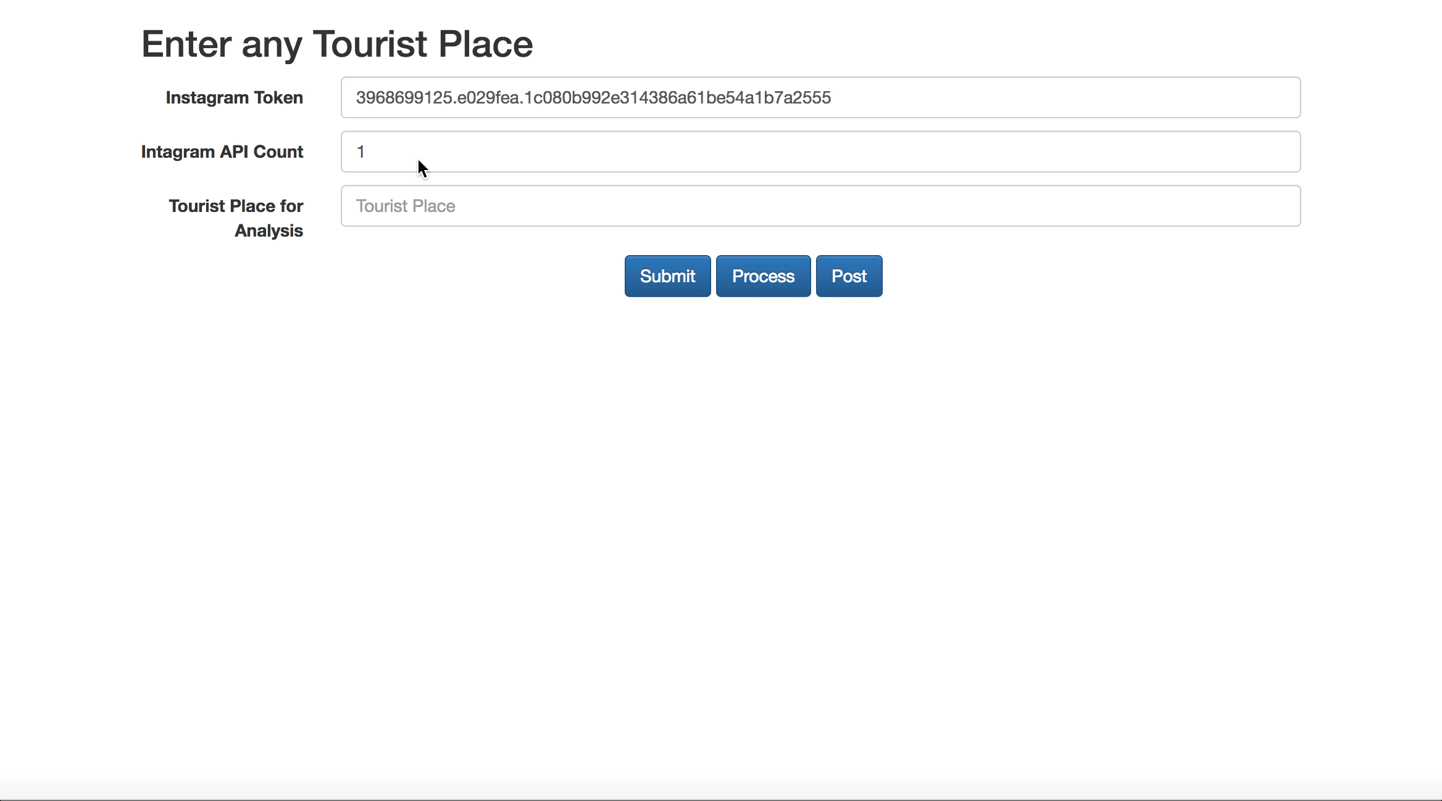

Slide 12
Instagram API Call

Slide 13
Instagram API Response

Slide 14
Microsoft Face API and Comments

Slide 15
Faces API

Slide 16
Microsoft API Response
Total 6 females
Smiling Faces
Predicted Age

Slide 17
Sending Data to R

Slide 18
Processing Data

Slide 19
Data frame from NodeJS

Slide 20
Data Frame Comments and Faces

Slide 21
Performing Operations

Slide 22
Processing Comments

Slide 23
Processing Comments

Slide 24
Processed Data of Comments and Faces

Slide 25
Sentiment Analysis: Comments
Using API based on Naive Bayes Model which was giving appropriate classification of result
Output which is Positive, Negative or Neutral
Removed the Neutral comment

Slide 26
Resulting Data Frames
Processed data from Microsoft Face API
Output Comment after Sentimental Analysis

Slide 27
Data returning to Node JS
R-Script converts Data Frame to JSON data
R-script also converts JSON data to Data Frame
The io.emit deliver the data to Angular JS
Socket.on('data', function (data) recieves the data in Web App

Slide 28
Received Data From R

Slide 29
Initial Data Received

Slide 30
Pie Chart and Bar Graph
Number of Females are greater than Male
The average age of Male is greater than the Average age of Female

Slide 31
Bar Graph Sentiment Analysis: Comments
Average of Positive Comments are more as compared to Average Negative Comments

Slide 32
Sentiment Analysis: Comments

Slide 33
Thank You
Milee Singh Ashawad

